Slide 1


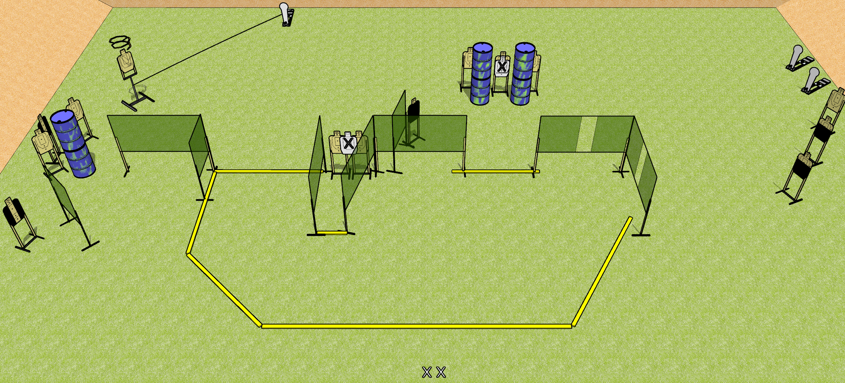
 | Dothan Gun Club – USPSA Match Scoot and Shoot Course Designer : Drew Coleman
START POSITION : Standing with both feet on X’s, wrists below belt
GUN READY CONDITION : Pistol loaded and holstered. PCC loaded, held with both hands, shouldered, safety on. |  | SCORING: Comstock, 31 rounds TARGETS: 14 paper, 3 Steel SCORED HITS: Best 2 on paper, steel until down START-STOP: Audible, last shot RULES: Drop turner is a disappearing target
STAGE PROCEDURE: Engage targets as they become available from within the fault lines.

Slide 2
Scoot and Shoot
Written Stage Briefing
Scoot and Shoot is a 31 round, 155 point, Comstock field course. There are fourteen USPSA targets and three Colt poppers. The best two hits on target will score, and steel must fall to score. The start signal is audible.
The drop turner is activated by the leftmost popper. It is a disappearing target. Please check the activator prior to walkthrough and set it the same way every time.
Handgun start position is both feet on X’s, wrists below belt. Handgun is loaded and holstered.
PCC start position is both feet on X’s. Loaded carbine is held with both hands, safety on.
On start signal, engage targets as they become available from within the shooting area.

